Slide 1

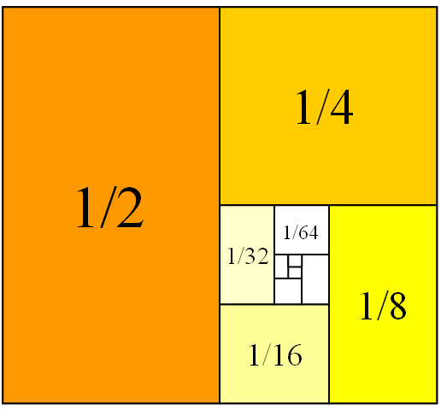
Mathematics for Engineering: Calculus
Chapter 3: TECHNIQUES OF INTEGRATION
Department of Mathematics, FPT University

Slide 2
Content
3.1 Integration by Parts
3.6 Numerical Intrgration
3.7 Improper Integrals

Slide 3
TECHNIQUES OF INTEGRATION
3.1
Integration by Parts
In this section, we will learn:
How to integrate complex functions by parts.

Slide 4
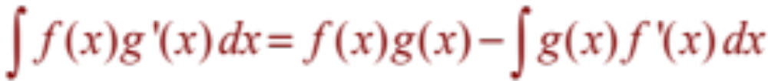
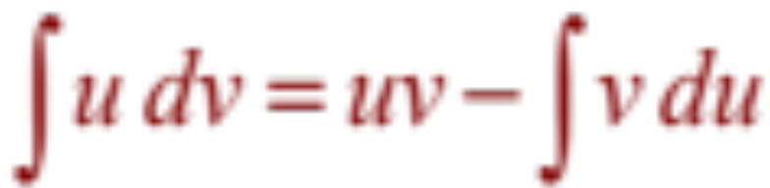
INTEGRATION BY PARTS
  Let u = f(x) and v = g(x).
  Then, the differentials are:
  du = f’(x) dx and dv = g’(x) dx
Thus, by the Substitution Rule, the formula for integration by parts becomes:
Notes:
Let u = ?; dv = ?
How to choose u and dv to make the resulting integral simpler.
The analogy with u-substitution: u-substitution is “undoing” the Chain Rule, and integration by parts is “undoing” the Product Rule.

Slide 5
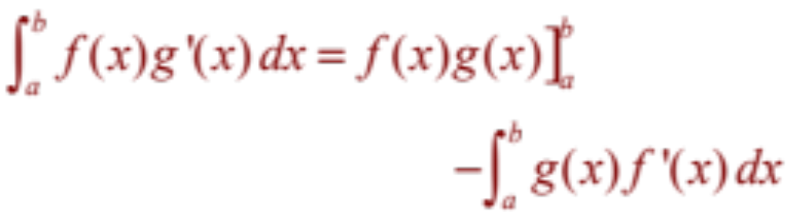
INTEGRATION BY PARTS
Evaluating both sides of Formula 1 between a and b, assuming f’ and g’ are continuous, and using the FTC, we obtain:

Slide 6
INTEGRATION BY PARTS
Example 1
Find ∫ x sin x dx

Slide 7
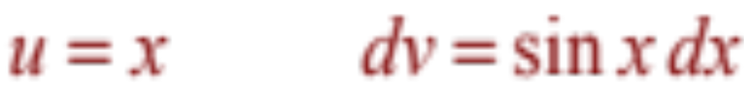

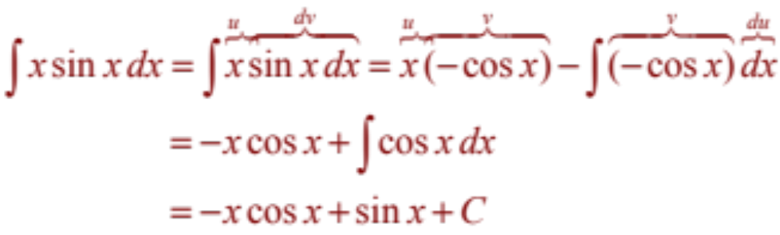
INTEGRATION BY PARTS
Example 1
Let
Then,
Using Formula 2, we have:

Slide 8
INTEGRATION BY PARTS
Example 2
Evaluate ∫ e^{x} sinx dx
  e^{x} does not become simpler when differentiated.
  Neither does sin x become simpler.

Slide 9
INTEGRATION BY PARTS
Example 2
Nevertheless, we try choosing
u = e^{x} and dv = sin x
  Then, du = e^{x} dx and v = – cos x.

Slide 10
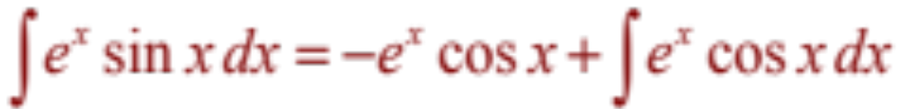
INTEGRATION BY PARTS
Example 2
So, integration by parts gives:

Slide 11
INTEGRATION BY PARTS
Example 2
The integral we have obtained, ∫ e^{x}cos x dx,
is no simpler than the original one.
  At least, it’s no more difficult.
  Having had success in the preceding example integrating by parts twice, we do it again.

Slide 12
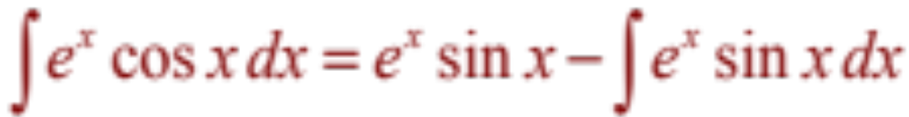
INTEGRATION BY PARTS
Example 2
This time, we use
u = e^{x} and dv = cos x dx
Then, du = e^{x} dx, v = sin x, and

Slide 13
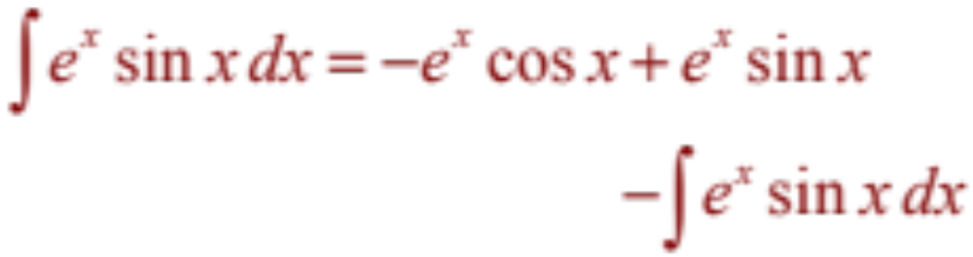
INTEGRATION BY PARTS
Example 2
we get:
  This can be regarded as an equation to be
  solved for the unknown integral.

Slide 14
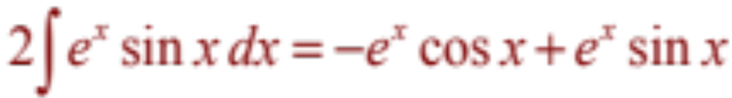
INTEGRATION BY PARTS
Example 2
Adding to both sides ∫ e^{x} sin x dx,
we obtain:

Slide 15
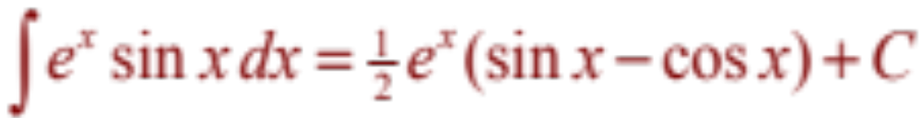
INTEGRATION BY PARTS
Example 2
Dividing by 2 and adding the constant
of integration, we get:

Slide 16
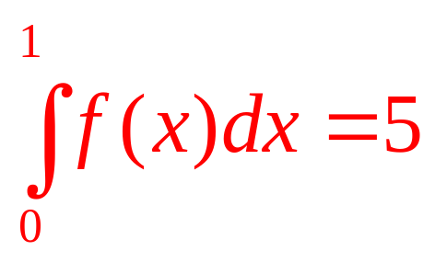
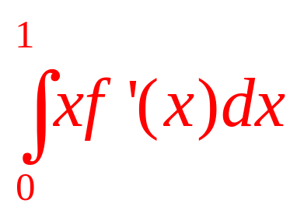
INTEGRATION BY PARTS
Example 3
Suppose f(x) is continuous and differentiable, f(1)=4 and Find
a | 4/5
b | 5/4
c | 1
d | None of the others
e | -1

Slide 17
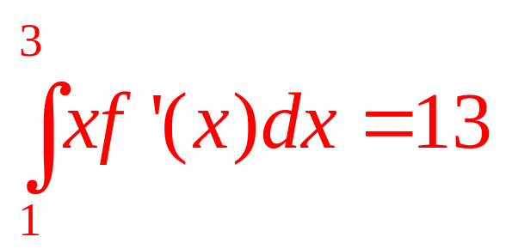
INTEGRATION BY PARTS
Example 4
Suppose f(x) is continuous and differentiable, f(1)=3, f(3)=1 and What is the average value of f on the interval [1,3]?

Slide 18
TECHNIQUES OF INTEGRATION
3.6
Numerical Integration

Slide 19
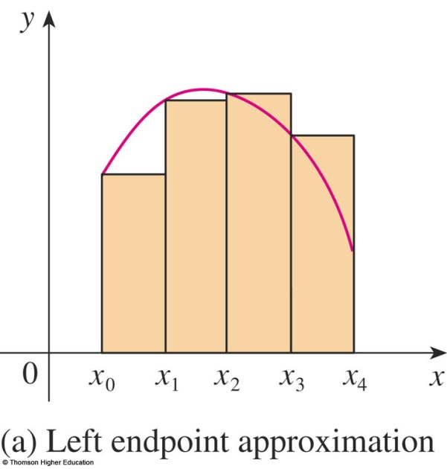
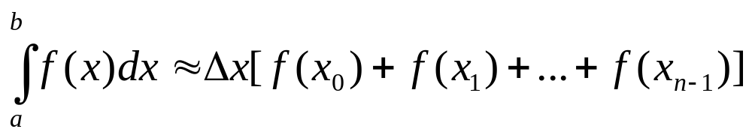
Numerical Integration
Left endpoint Method

Slide 20
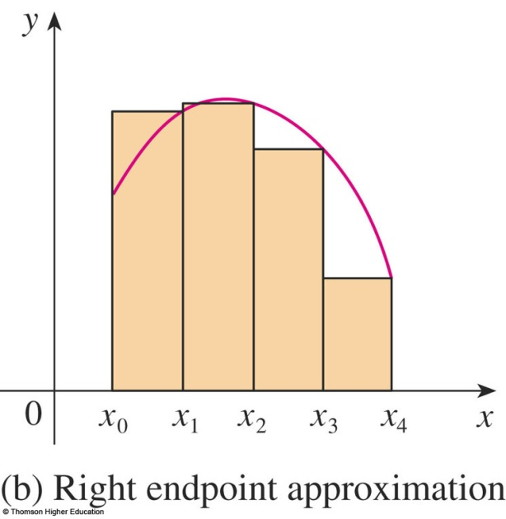
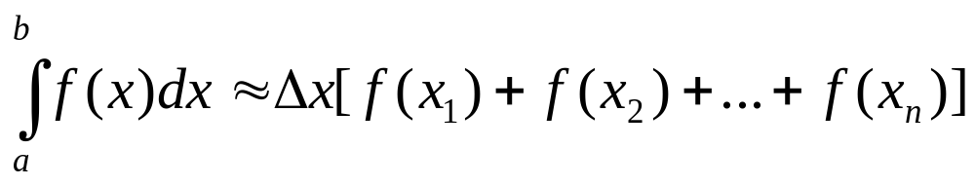
Numerical Integration
Right endpoint Method

Slide 21
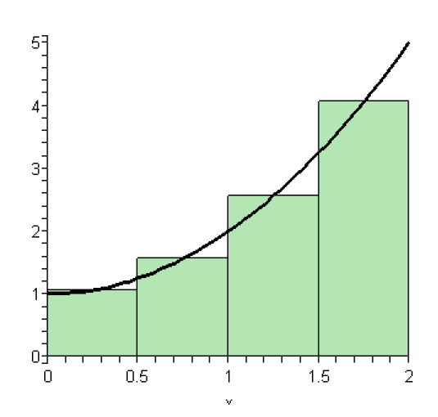




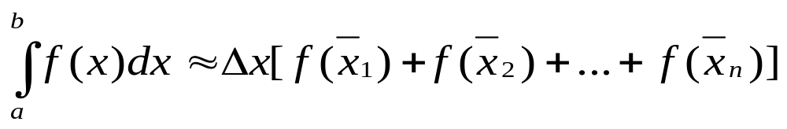
Numerical Integration
Midpoint Method
f(x)
∆x

Slide 22
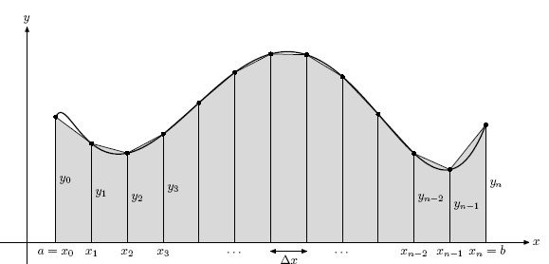
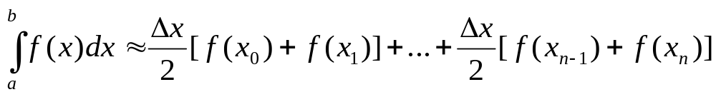
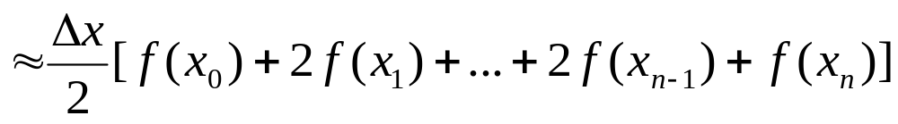
Numerical Integration
Trapezoidal Method

Slide 23
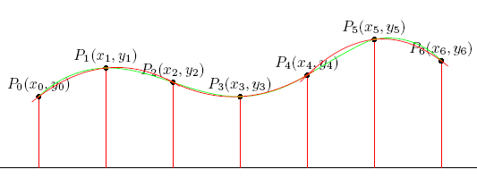
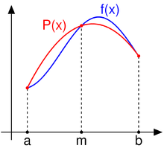
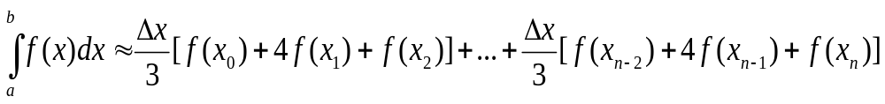
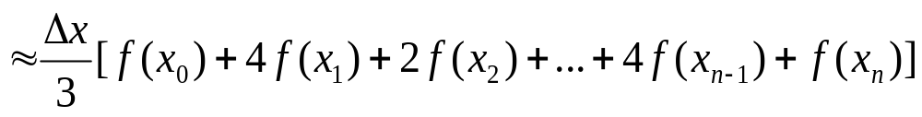
Numerical Integration
Simpson Method

Slide 24
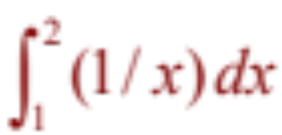
Numerical Integration
Example
Approximate the integral
with n = 8, using:
a. Left/Right endpoints
b. Midpoints
c. Trapezoidal method
d. Simpson method

Slide 25
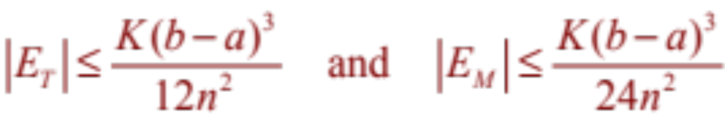
Numerical Integration
Estimate error for Midpoint and Trapezoidal method
Suppose | f’’(x) | ≤ K for a ≤ x ≤ b.
If E_{T} and E_{M} are the errors in the Trapezoidal and Midpoint Rules, then

Slide 26
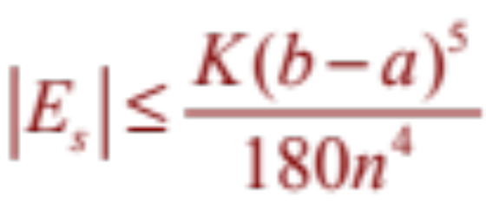
Numerical Integration
Estimate error for Simpson method
Suppose | f⁽⁴⁾(x) | ≤ K for a ≤ x ≤ b.
If E_{S} is the error in the Simpson method, then

Slide 27

Numerical Integration
Example
How large should we take n in order to guarantee
that the Trapezoidal, Midpoint Rule, Simpson rule
approximations for
are accurate to within 0.0001?

Slide 28
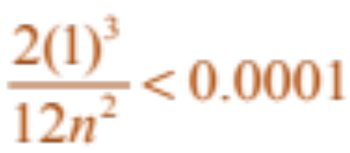
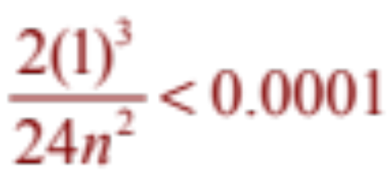
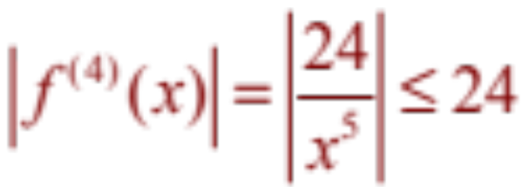
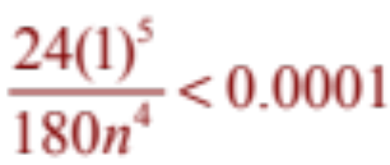
Numerical Integration
| f’’(x) | ≤ 2 for 1 ≤ x ≤ 2
Accuracy to within 0.0001 means that error < 0.0001
Trapezoidal: Choose smallest n so that: → n = 41
Midpoint: → n = 30
Simpson:
→
→
n = 8

Slide 29
TECHNIQUES OF INTEGRATION
3.7
Improper Integrals
In this section, we will learn:
How to solve definite integrals
where the interval is infinite and
where the function has an infinite discontinuity.
Notes:
What is the improper integrals of type I, II?
A careful definition of convergence and divergence as related to improper integrals of type I, II.
The comparison theorem to determine that improper integrals convergence and divergence.

Slide 30
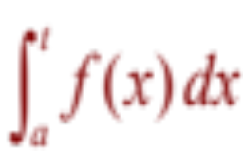
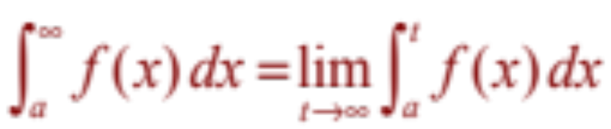
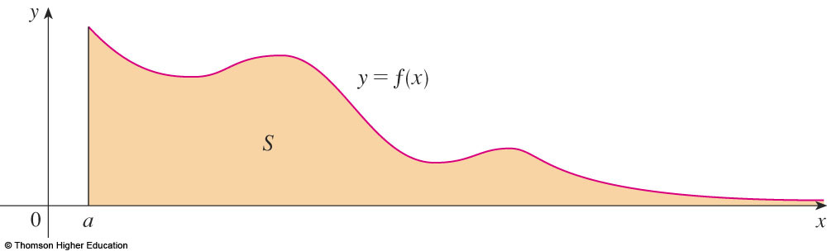
IMPROPER INTEGRAL OF TYPE 1
Definition
If exists for every number t ≥ a, then
provided this limit exists (as a finite number).

Slide 31
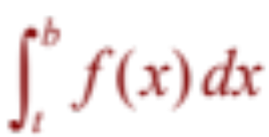
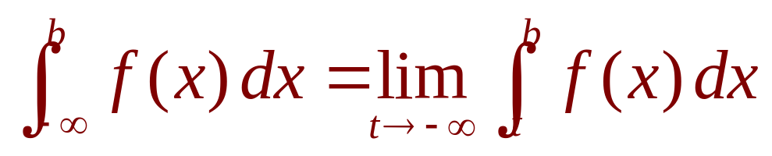
IMPROPER INTEGRAL OF TYPE 1
Definition
If exists for every number t ≤ a, then
provided this limit exists (as a finite number).

Slide 32
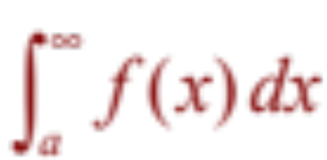
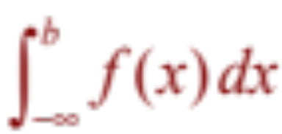
CONVERGENT AND DIVERGENT
IMPROPER INTEGRAL OF TYPE 1
Definition
The improper integrals and
are called:
  Convergent if the corresponding limit exists.
  Divergent if the limit does not exist.

Slide 33
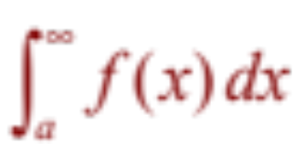
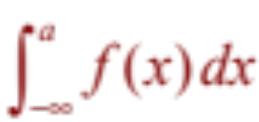
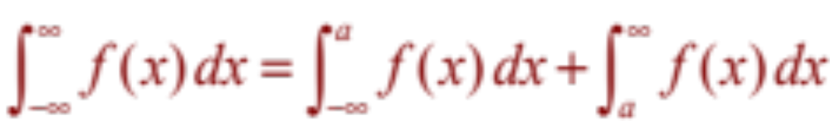
IMPROPER INTEGRAL OF TYPE 1
Definition
If both and are convergent, then we define:
  Here, any real number a can be used.

Slide 34
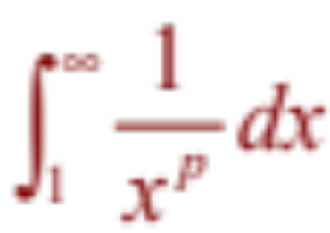
IMPROPER INTEGRAL OF TYPE 1
Example 1
For what values of p is the integral
convergent?
  Convergent if p > 1
  Divergent if p ≤ 1

Slide 35
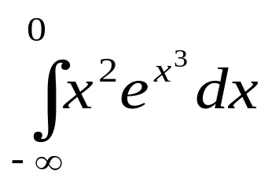
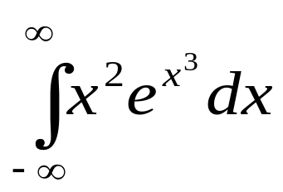
IMPROPER INTEGRAL OF TYPE 1
Example 2
Investigate the convergence of the improper integrals:
(a)
(b)

Slide 36
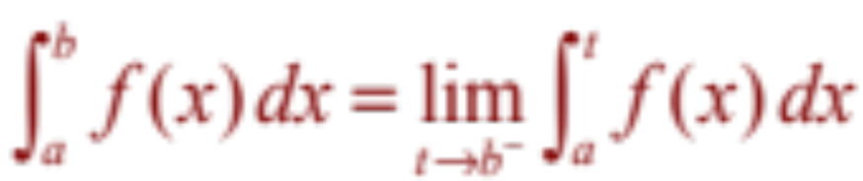
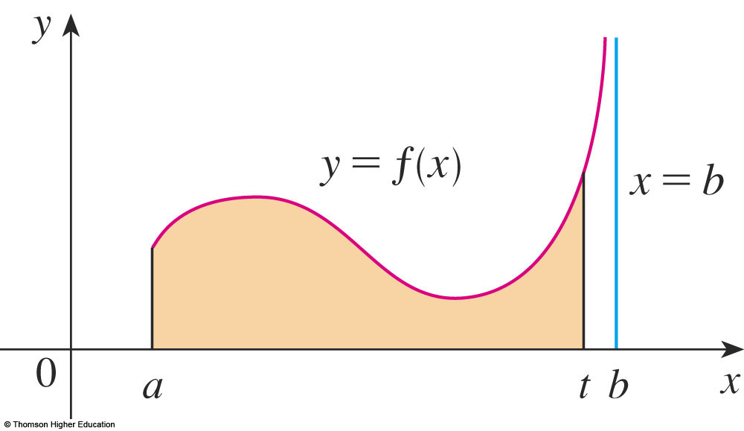
IMPROPER INTEGRAL OF TYPE 2
Definition
If f is continuous on [a, b) and is discontinuous at b, then
if this limit exists (as a finite number).

Slide 37

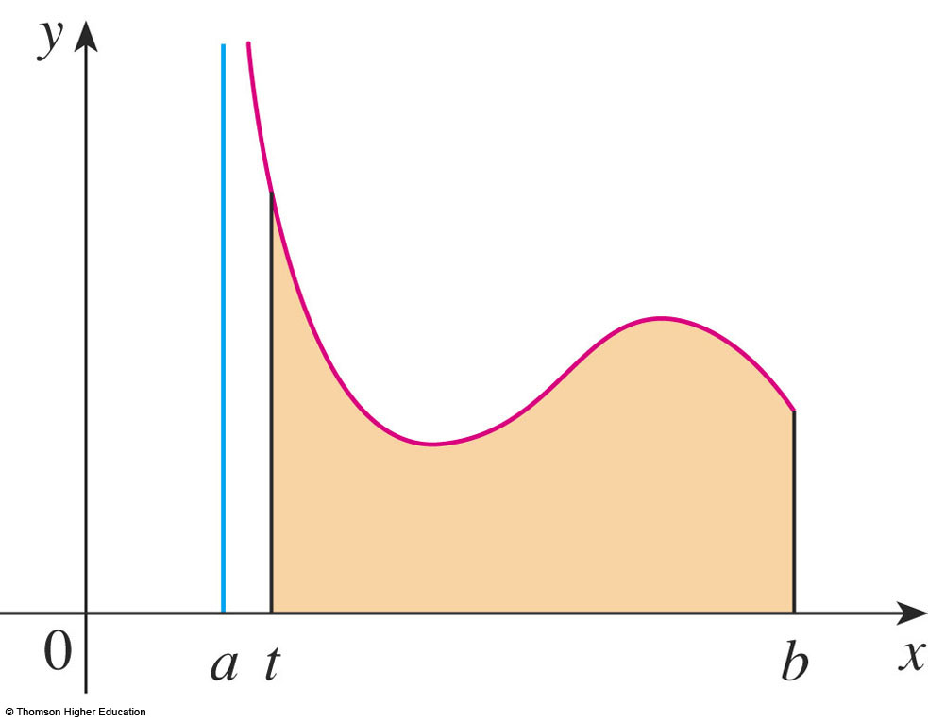
IMPROPER INTEGRAL OF TYPE 2
Definition
If f is continuous on (a, b] and is discontinuous at a, then
if this limit exists (as a finite number).

Slide 38

IMPROPER INTEGRAL OF TYPE 2
Definition
The improper integral is called:
  Convergent if the corresponding limit exists.
  Divergent if the limit does not exist.

Slide 39




IMPROPER INTEGRAL OF TYPE 2
Definition
If f has a discontinuity at c, where a < c < b, and
both and are convergent, then we define:

Slide 40


IMPROPER INTEGRAL OF TYPE 2
Example 1
Let b> 2. Investigate the convergence of the improper integrals:
Answer: diverges if p 1 and converges if p<1.

Slide 41

IMPROPER INTEGRAL OF TYPE 2
Example 2
Investigate the convergence of the improper integral:

Slide 42




COMPARISON THEOREM
Suppose f and g are continuous functions with f(x) ≥ g(x) ≥ 0 for x ≥ a.
  If is convergent, then
  is convergent.
  If is divergent, then
  is divergent.
Note: A similar theorem is true for Type II integrals
Notes:
For example…

Slide 43



COMPARISON THEOREM
Example
Example
Does converge?
We have,
and converges
→ I converges.
Notes:
For example…

Slide 44



COMPARISON THEOREM
Example
Example
Investigate the convergence of the improper integrals
(a)
(b)
(c)
Notes:
For example…

Slide 45
Thanks

